Slide 1
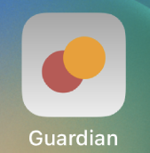
Guardian --Personal Safety Mobile App
Siyu Yao (April) - 20216468
Notes:
Good afternoon everyone, I extend my warmest welcome to each one of you, as we gather here today to explore the realm of personal safety. My name is Siyu Yao, you can also call me April, and I am honoured to present my final year project, a personal safety mobile app called‘Guardian.’
Throughout this presentation, I will showcase the capabilities of 'Guardian' and demonstrate how it can revolutionise the way we approach personal safety. However, before delving into the app itself, I invite you to join me and let us first examine the pressing problem that drives our mission.

Slide 2
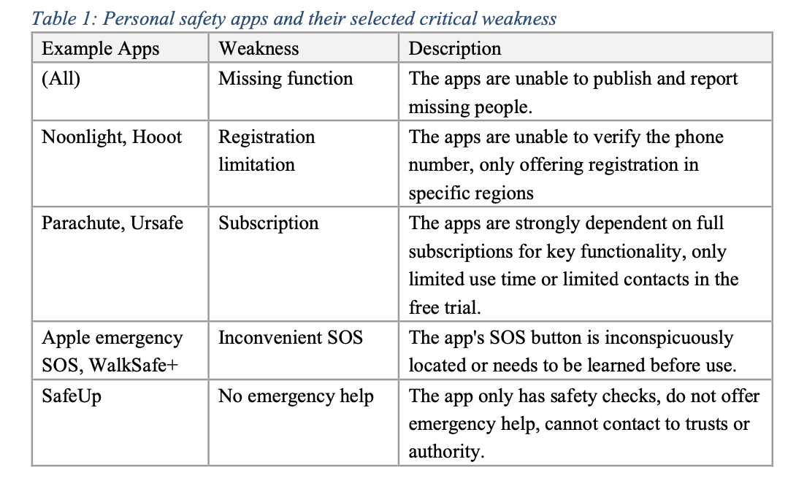
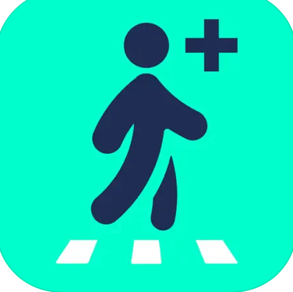
What drives the mission?
Sarah Everard murder (Mar. 2021)¹
Back home alone at night
The next day, WalkSafe+ was downloaded by 500,000 people²
Sabina Nessa death (Sep. 2021) ³
On her way to see friends, 5-min walk
Existing solutions lack effectiveness
Notes:
Within our social lives, we often encounter moments of fear and helplessness when faced with sudden danger. Tragically, these concerns were vividly underscored by the devastating incidents involving Sarah Everard and Sabina Nessa in London in 2021. Sarah was murdered while making her way home alone at night, and the following day, a surge in demand for personal safety solutions was witnessed, with 500,000 people downloading the WalkSafe app ‘just in case’. Similarly, Sabina's tragic death occurred during a seemingly routine 5-minute walk to meet friends.
While numerous applications claim to address these concerns, they frequently fall short in crucial areas, as shown in the table here.
----
It is clear that a comprehensive and innovative approach is needed to bridge these gaps and provide ind ividuals with a reliable and inclusive personal safety solution.
Luckily, we have Guardian. Guardian stands apart with its unwavering dedication to security, striving to overcome the challenges present in existing solutions. Imagine having a trusted companion, always ready to respond in times of need - that's what Guardian brings to you, with its cutting-edge features and user-centric design.

Slide 3

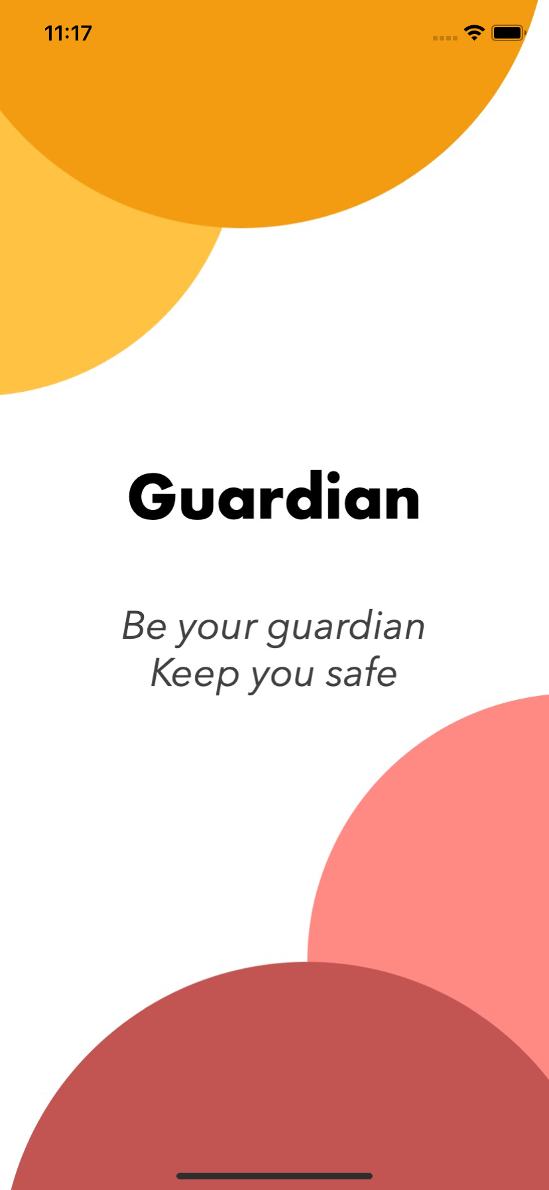
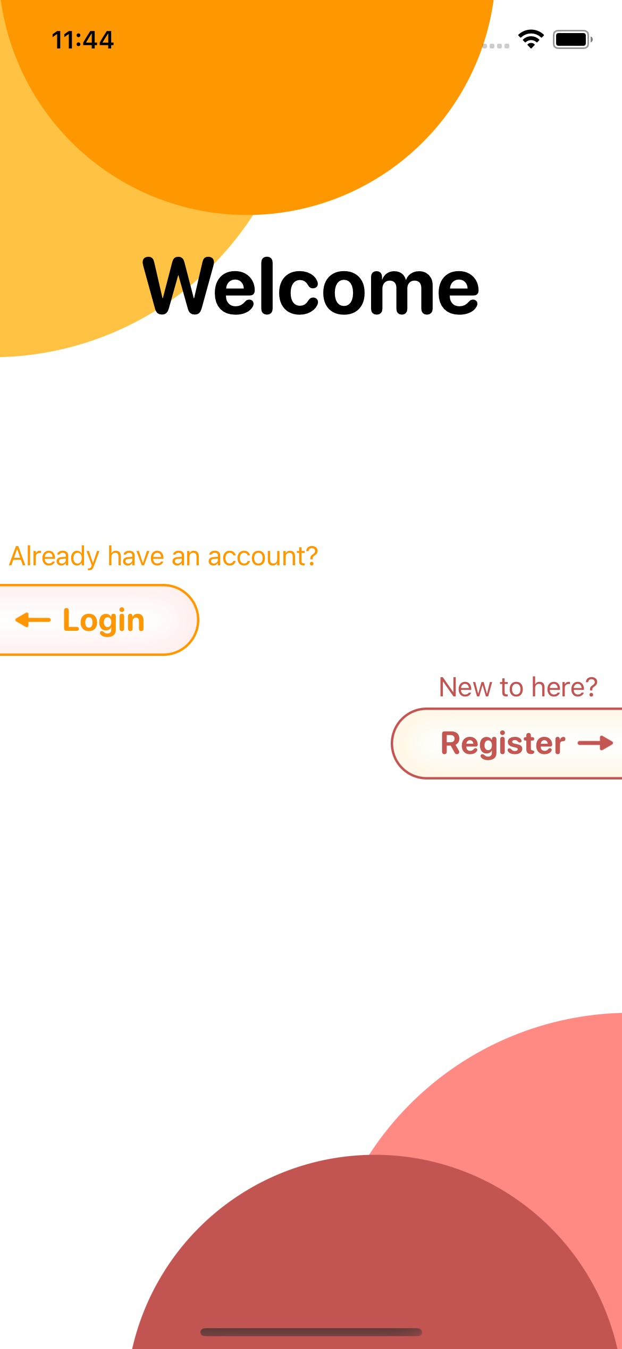
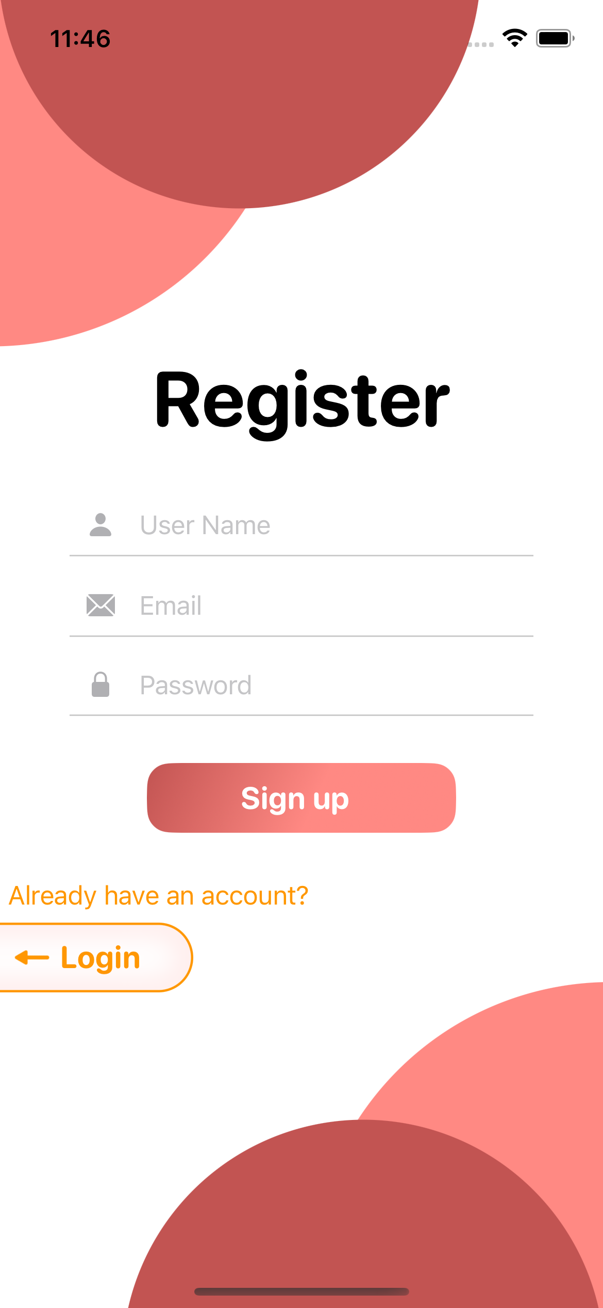
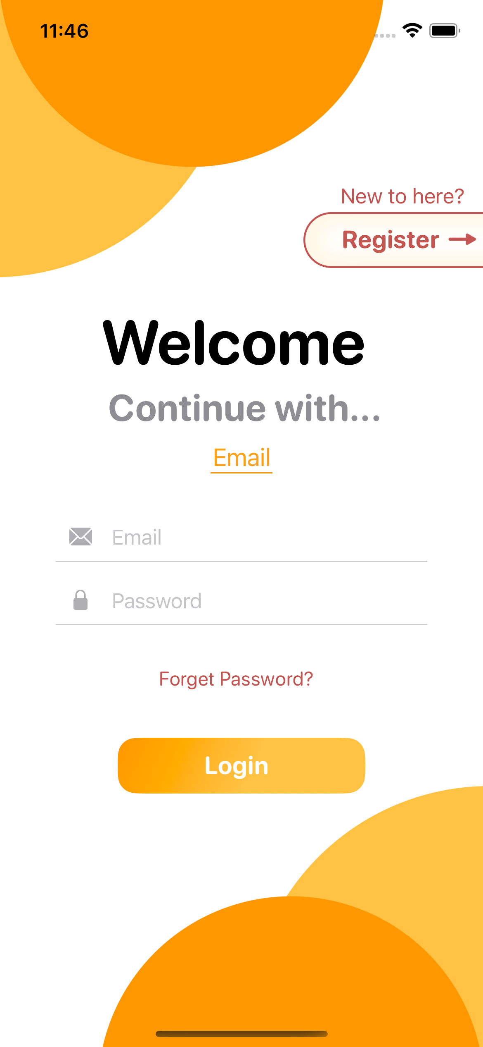
Superpowers at Your Fingertips: Meet Guardian
Onboarding
launch screen
welcome screen
register / login
Account
profile management
audio management
log out / delete
demo account: test03@test.com 123456 5555
Notes:
It's not just an app, but a powerful tool that offers a suite of safety superpowers at your fingertips.
Like all good apps, Guardian begins with a user-friendly onboarding process, as you can see in the screenshots. This includes a launch screen, a welcome screen, and a simple registration and login process. And Firebase serves as the trusted backend database where all the data is stored. (change to simulator)
Once logged in, a handy navigation tab bar allows you to explore the app's rich features. Let's start by exploring the Account Menu. Here, users can manage their profile information, log out, or even delete their accounts. You'll also notice an Audio Management submenu, which currently appears empty, but I assure you, we'll circle back to this intriguing feature shortly.
Next, let's dive into the Home Menu, your personal control centre in Guardian. Here, you can quickly manage your contacts by simply using a drag gesture. Adding, modifying details, setting emergency contacts, or deleting them is as easy as a tap.

Slide 4
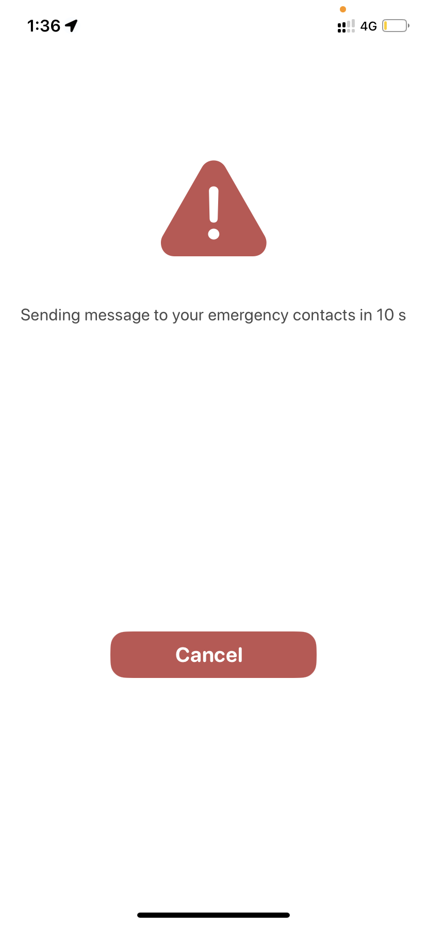
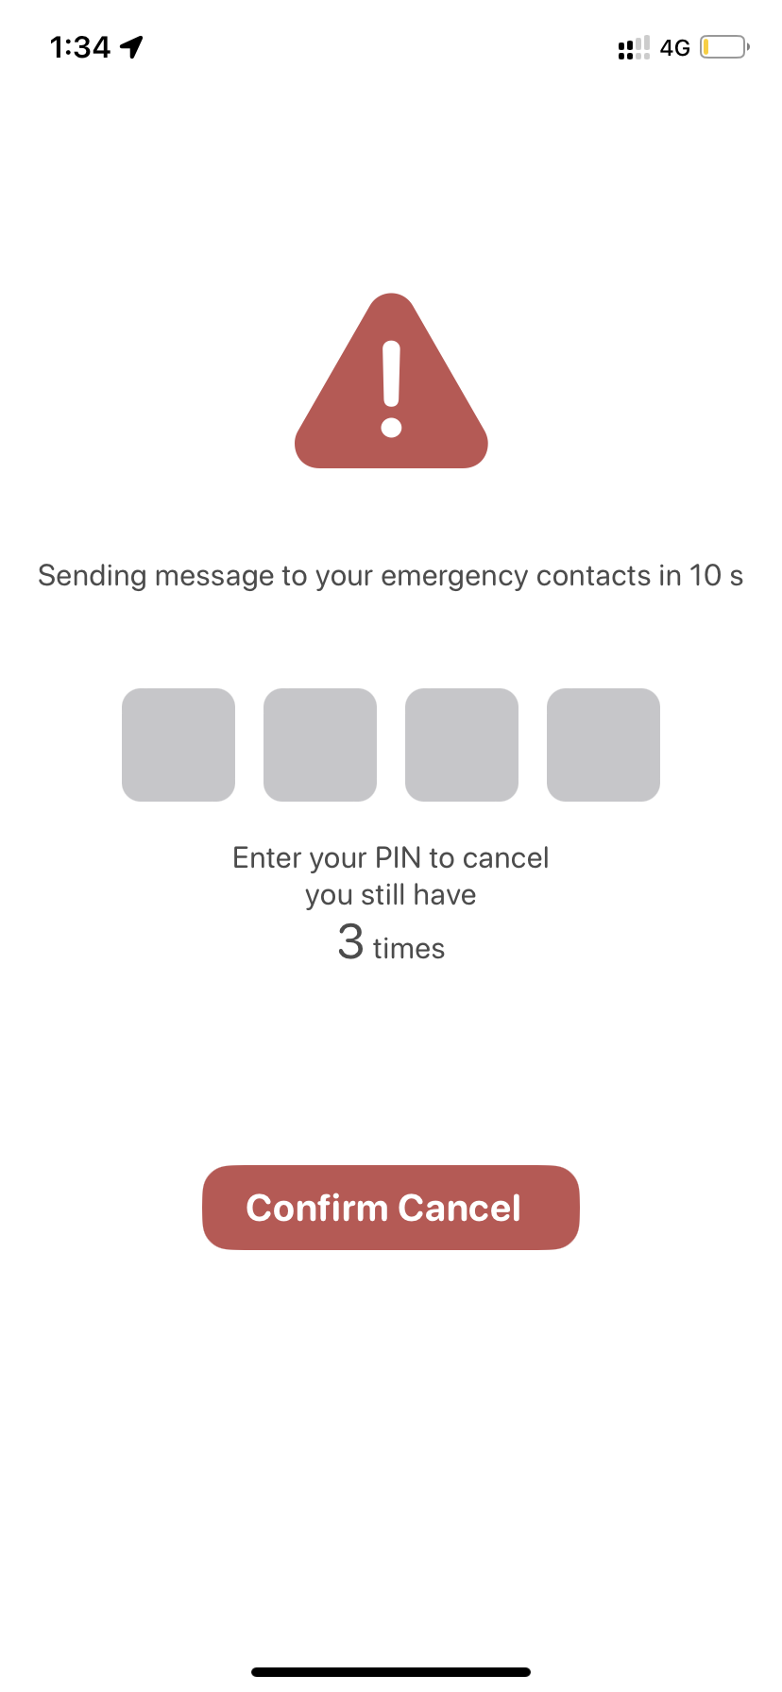
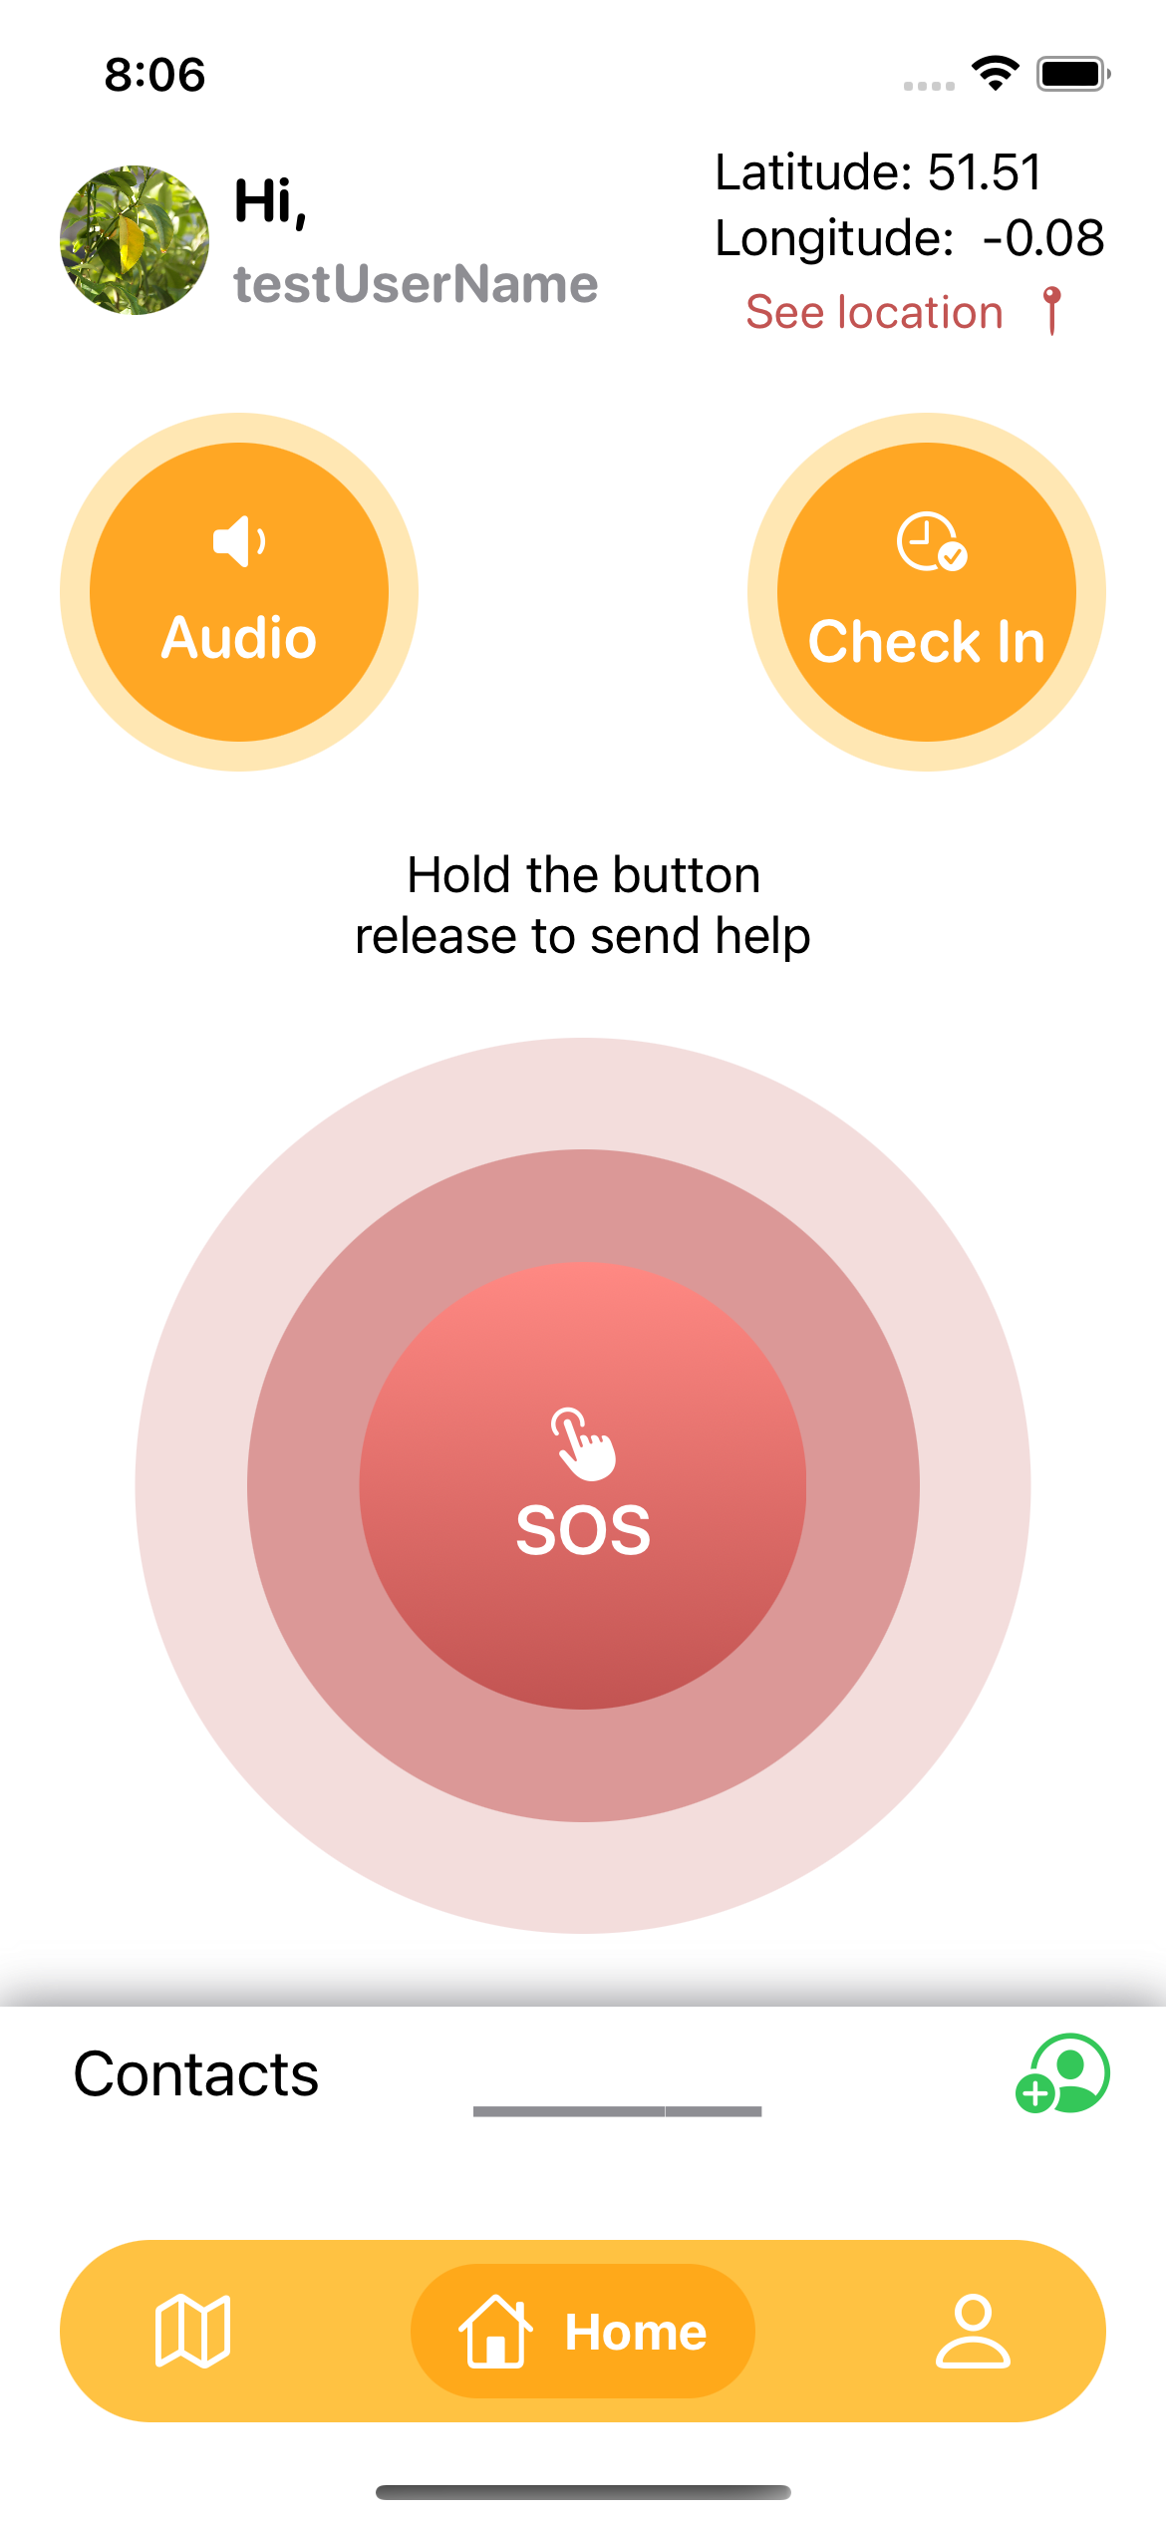
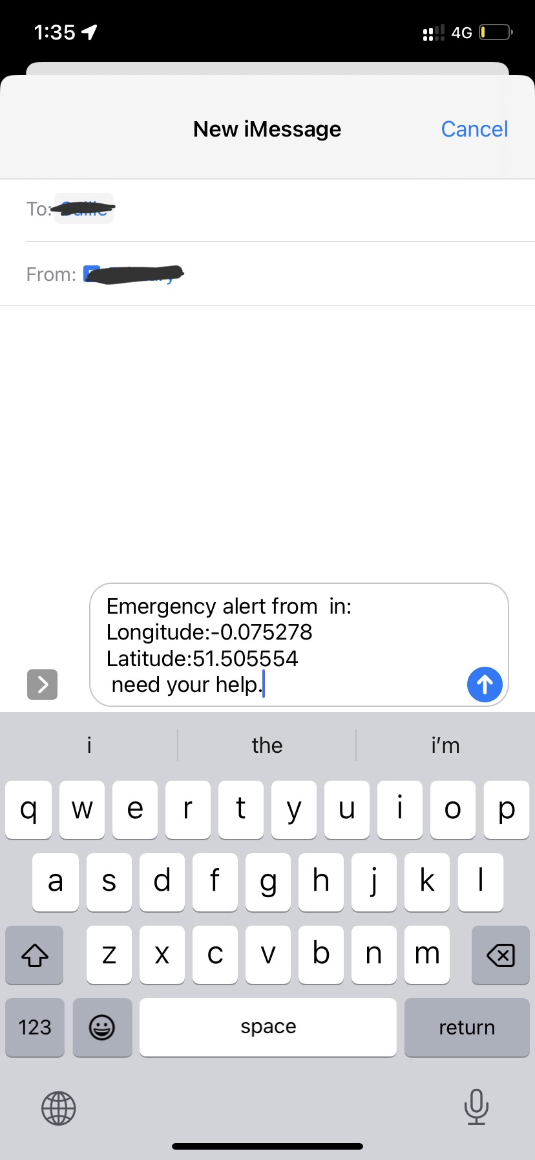

Superpowers at Your Fingertips: Meet Guardian
Contacts
add/ delete
modify details/ set as emergency
Main Button
begin / stop audio recording
send message
Check-In
begin/ stop check-in timer
begin/ stop audio recording
send message
Notes:
If you ever feel uneasy, Guardian is ready to be your silent protector. Hold the red main button, and relax - nothing happens, but the audio begins to record, capturing the surrounding sounds. Release the button, and the audio recording stops as a 10-second countdown starts ticking， as shown the screenshots here. If you fail to enter the correct PIN or let the timer reach 0, Guardian jumps into action. A predefined emergency message is prepared to alert your chosen contacts via the Messages app.
**************************
But what if you don‘t want to hold the main button for a long time? Guardian has you covered with the Check-In feature, a new addition that sets us apart. This feature lets you set a timer and starts recording audio when activated and stops when you end it. This recording, a potential life-saver, can be toggled on and off with the audio button. And we can see the recorded audio here, playback or delete it.
************************
Let's explore the Map menu now. This unique feature of Guardian allows you to add new unsafe reports or even missing person reports with the 'New Report' button. You have the flexibility to choose a location - either your current location or a specific one on the map. For a missing person report, Guardian requires you to provide essential information. By simply tapping the pin on the map, you can access the report details and even remove the report if necessary. If you created this report, it's as simple as a tap to delete.

Slide 5
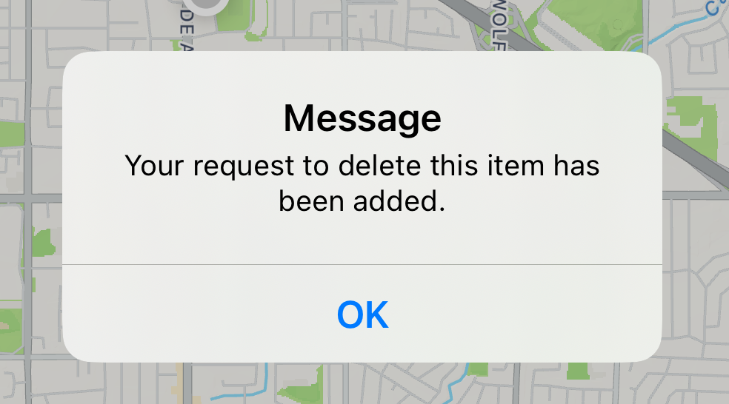
Superpowers at Your Fingertips: Meet Guardian
Unsafe Reports
add new reports by choosing a location
check details on Map
delete the report
Missing Person Reports
add new reports by location and essential information
check details on Map
delete the report
Notes:
However, if you're not the original source, the app will need a second user to request delete before deleting it from the database, and you will get a message like the screenshot here.
Now, let's understand the heart of the Map menu - your ability to report unsafe situations or missing persons. With a few taps, you can create a report, and Guardian will display your report as a new pin on the map, visible to all users. Imagine the power of community safety here, with each report potentially saving lives or averting dangerous situations. You're not just a user of an app; you're an active participant in building a safer community.

Slide 6
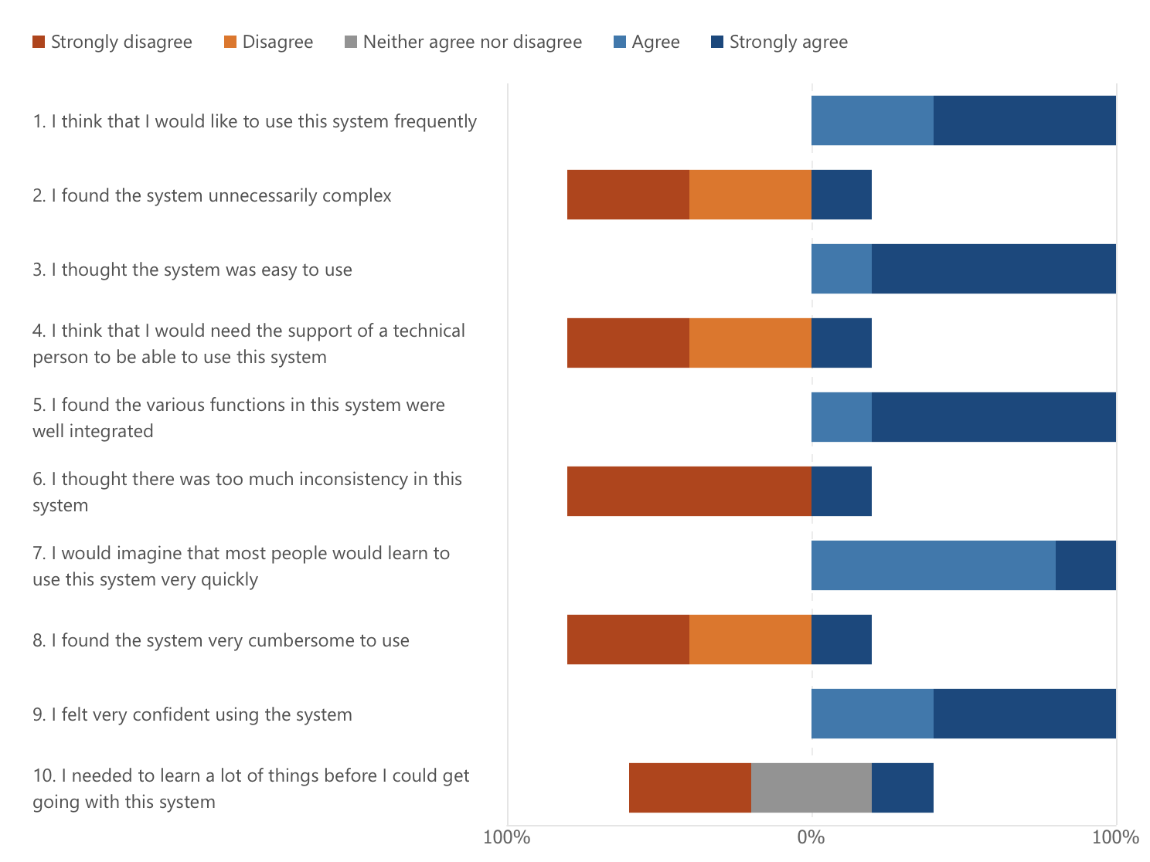
Putting Guardian to the Test: Triumphs and Challenges
Unit Test
40 test cases
34% test coverage
Usability Test
Beta test through the task list
5 SUS questionnaire, score 35/40
Some feedback:
No difference between the tester’s own report and others’ reports
Drag gesture for contacts list is hard to find
Notes:
Now, I would like to walk you through how I've put Guardian to the test - shedding light on both the triumphs and challenges I've encountered. In the unit test stage, a total of 40 test cases were created, focusing on individual components and methods. All of them passed and achieved 34% test coverage. While this number might seem low, the tests primarily focused on the app's implementation itself rather than the outside dependence, such as backend Firebase functionality.
In the usability test stage, I conducted a beta test, having users navigate through a task list and providing feedback via the System Usability Scale questionnaire. The result of the total 5 questionnaires can be found here. With a score of 35 out of 40, the feedback was generally positive, reflecting a high level of user satisfaction, efficiency, and ease of use.
However, the feedback also highlighted certain challenges. Firstly, users found it difficult to distinguish between their own reports and others on the map, which indicated a need for improved visual cues or filtering options. Secondly, the drag gesture to access the contact list was found to be less intuitive, suggesting might need to make this feature easier to access.

Slide 7





What’s next?
Subscribable premium version
In-app walk through user guidance
Customisable emergency message
Biometric authentication
Localisation
automatic message sending
Allow customising the content of the emergency message
e.g., fingerprint or face recognition as an alternative to PIN entry
Support multiple languages and region-specific messaging services
Notes:
Having shared the triumphs and challenges of Guardian, it’s time to look at what’s on the horizon. First, we can have a premium version with functions like automatic message sending. Next is an in-app walkthrough user guidance to enhance user understanding and interaction with the app’s features. The third is allowing users to customise their emergency messages’ content, providing a more targeted alert to their contacts. For added security and convenience, integrating biometric authentication, such as fingerprint or face recognition, can be an alternative to the current PIN entry system. Finally is localisation, it can broaden the reach of Guardian, and support multiple languages and region-specific messaging services.
**********
Guardian’s power lies in its simplicity and effectiveness. It transcends the boundaries of a mere application, evolving into your round-the-clock digital guardian, designed to offer peace of mind and keep you safe in a complex world. With its user-friendly interface and innovative features, Guardian redefines personal safety, providing a virtual shield of protection that never sleeps.

Slide 8
Thank you for listening
Q&A
Bibliography
[1]. Sarah Everard “brought joy to our lives”, says her family. BBC News [Internet]. 2021 Mar 11; Available from: https://www.bbc.co.uk/news/uk-england-london-56367223 [2]. Sarah Everard one year on: The people trying to make change. BBC News [Internet]. 2022 Mar 3; Available from: https://www.bbc.co.uk/news/newsbeat-60507709
[3]. Sabina Nessa: Teacher killed on walk to meet friend. BBC News [Internet]. 2021 Sep 23; Available from: https://www.bbc.co.uk/news/uk-england-london-58661926
Notes:
That’s all for me today. Thank you for listening.

Slide 9
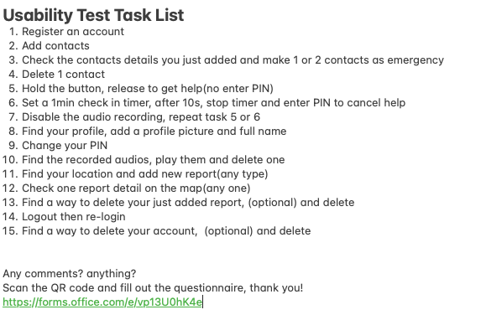
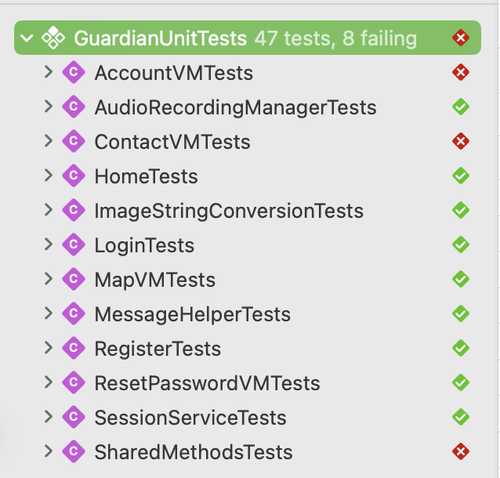
SUS result
Notes:
Limitations:
accessibility: haptic feedback is lacking
“lost and found” only lost right now
Difficulties:
Implementation: Audio (AVFundation)
Rapid iteration of iOS (15 vs 16) XCode
Test: Mock the Firebase behaviour

Slide 10
